Slide 1


INTRODUCTION TO PROGRAMMING
A Quest Global Company

Slide 2
List of Topics to be covered
Introduction to Programming
Variables, Data Types, and Operators
Conditional Statements & Loops
Functions & Modular Programming
Arrays and Strings

Slide 3
1. Introduction to Programming
A programming language is a set of instructions and syntax used to create software programs. It is a collaboration between humans and computers, in which humans create instructions for a computer to follow code in a language computer can understand.
Programming Languages:-
There are many programming languages, each with its syntax. Some popular languages include:-
Python: Known for its readability and simplicity. Widely used for Web, Desktop
Java: Widely used for web and enterprise applications.
JavaScript: Essential for web development, making websites interactive.
C++: Widely used for Mobile, Desktop, Embedded.

Slide 4
1. Introduction to Programming
Compiled:-
A compiled language is a programming language that is generally compiled and not interpreted.
It is one where the program, once compiled, is expressed in the instructions of the target machine; this machine code is undecipherable by humans.
Types of compiled language – C, C++, C#
Interpreted​:-
An interpreted language is a programming language that is generally interpreted, without compiling a program into machine instructions. ​
It is one where the instructions are not directly executed by the target machine, but instead, read and executed by some other program. ​
Interpreted language ranges – JavaScript, Perl, Python.

Slide 5
1. Introduction to Programming
Aspect | Compiled Languages | Interpreted Languages
Execution | Entire program is compiled into machine code first, then executed. | Code is interpreted and executed line-by-line at runtime.
Compilation | Compilation is required before execution. | No compilation needed; interpretation happens at runtime.
Execution Speed | Generally faster because machine code runs directly. | Generally slower because code is translated line-by-line.
Error Detection | Errors are detected during the compilation process. | Errors are detected at runtime, potentially during execution.
Portability | Less portable; compiled binaries are specific to the platform. | More portable; source code can run on any platform with an interpreter.
Memory Usage | Requires more memory upfront for storing the compiled executable. | Requires less memory for interpretation but can consume more during execution.
Examples | C, C++, Rust, Go | Python, JavaScript, Ruby, PHP
Tools | Compiler (e.g., g++, java) | Interpreter (e.g., python, node)
Code Distribution | Binary executable is distributed; source code may not be needed. | Source code is distributed; the interpreter is required to run the code.
Development | Slower for development as recompilation is needed after changes. | Faster for development, as changes can be run immediately without recompilation.

Slide 6
1. Introduction to Programming
Setting up the programming environment: - For setting up a C++ Integrated Development Environment (IDE) on our local machine. They are few applications to work on code changes.
Install proper IDE like for
Java -> Eclipse
C or C++-> Dev C++, VS code, Turbo C.
Python -> PyCharm .
Here we are using the Qt Creator for Coding exercises

Slide 7
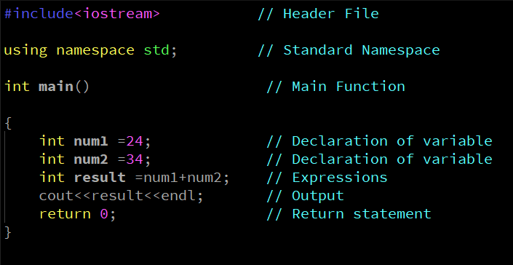
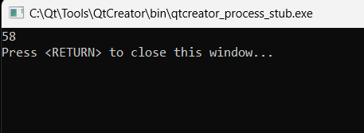
1. Introduction to Programming
Basic Syntax of a C++ Program:-
Example
Output

Slide 8
2. Variables, Data Types, and Operators
A variable is only a name given to a memory location all the operations done on the variable effects that memory location. In C++, all the variables must be declared before use.
data type int age = 15; Value
Variable name
Rules For Declaring Variable
The name of the variable contains letters, digits, and underscores.
The name of the variable is case sensitive (ex Arr and arr both are different variables).
The name of the variable does not contain any whitespace and special characters (ex #,$,%,*,etc).
All the variable names must begin with a letter of the alphabet or an underscore(_).
We cannot used C++ keyword (ex float, double, class)as a variable name.

Slide 9
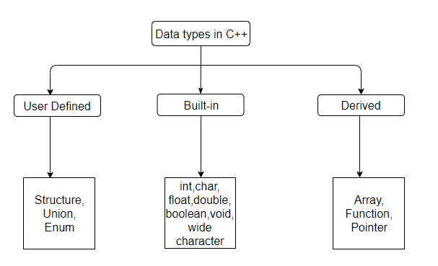
2. Variables, Data Types, and Operators
Data Types:- C++ supports the following data types:
Primary or Built-in or Fundamental data type
Derived data types
User-Defined data types

Slide 10
Data types Storage and Range:-
2. Variables, Data Types, and Operators
Data Type | Storage Size | Value Range (Signed) | Value Range (Unsigned)
char | 1 byte | -128 to 127 | 0 to 255
short | 2 bytes | -32,768 to 32,767 | 0 to 65,535
int | 4 bytes | -2,147,483,648 to 2,147,483,647 | 0 to 4,294,967,295
long | 4 bytes | -2,147,483,648 to 2,147,483,647 | 0 to 4,294,967,295
long long | 8 bytes | -9,223,372,036,854,775,808 to 9,223,372,036,854,775,807 | 0 to 18,446,744,073,709,551,615
float | 4 bytes | ~ ±3.4e−38 to ±3.4e+38 | N/A
double | 8 bytes | ~ ±1.7e−308 to ±1.7e+308 | N/A
long double | 10-16 bytes | ~ ±3.4e−4932 to ±1.1e+4932 | N/A
bool | 1 byte | 0 (false) or 1 (true) | N/A

Slide 11
2. Variables, Data Types, and Operators
Operators in C++ can be classified into 6 types:
1. Arithmetic Operators
Relational Operators
Logical Operators
Bitwise Operators
Assignment Operators
Ternary or Conditional Operators
Operator | Type
++,-- | Unary Operator
+,-,*,/,% | Arithmetic Operator
<,<=,>,>=,==,!= | Relational Operator
&&, ||, ! | Logical Operator
&,|,<<,>>,~,^ | Bitwise Operator
=,+=,-=,*=,/=,%= | Assignment Operator
?: | Ternary or Conditional Operator

Slide 12
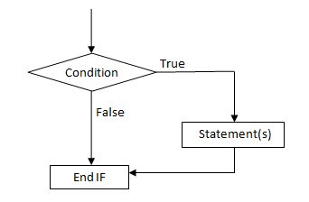
3. Conditional Statements & Loops
Conditional statements in programming are used to control the flow of a program based on certain conditions.
Types of Conditional Statements
If Statement
If -else Statement
If –else-if Statement
Switch Statement
Ternary operator
If Statement

Slide 13
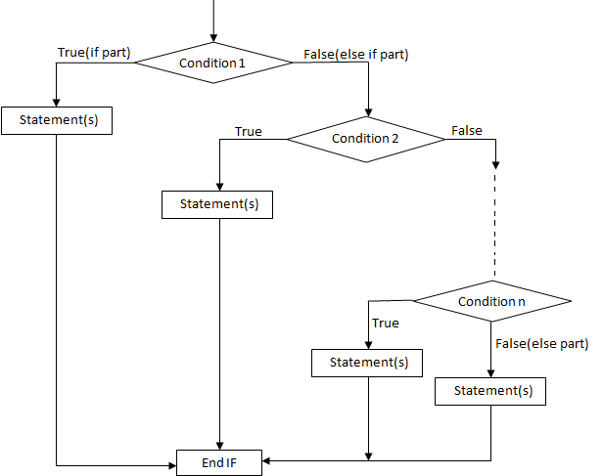
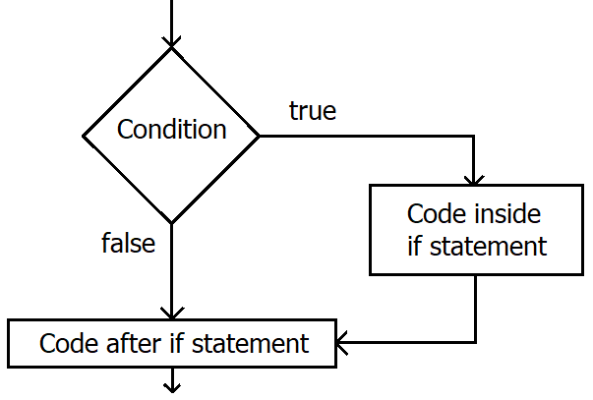
3. Conditional Statements & Loops
If-else Statement
If-else if Statement

Slide 14
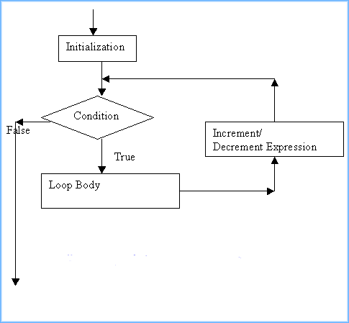
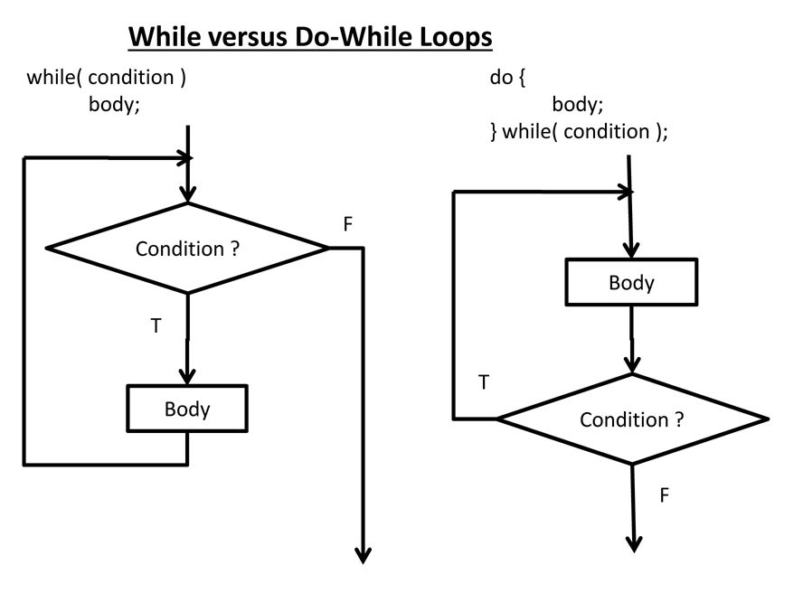
3. Conditional Statements & Loops
For Loop Statement
While Statement
Do While Statement

Slide 15
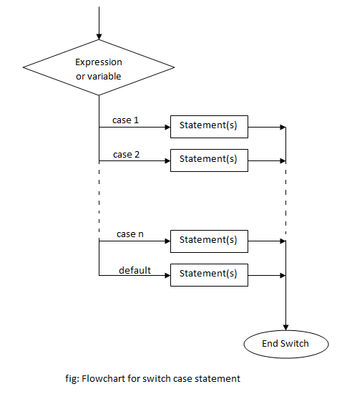
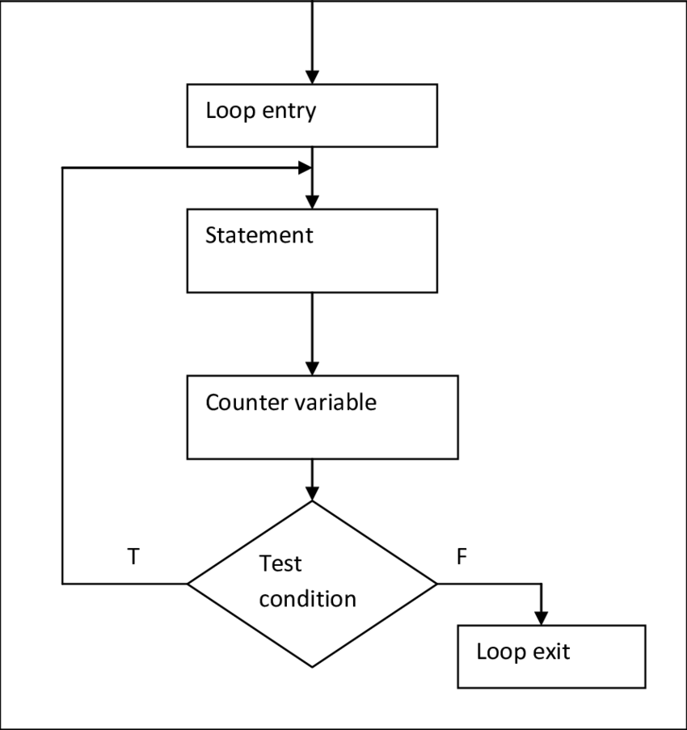
3. Conditional Statements & Loops
Loop Statement
Switch Statement

Slide 16
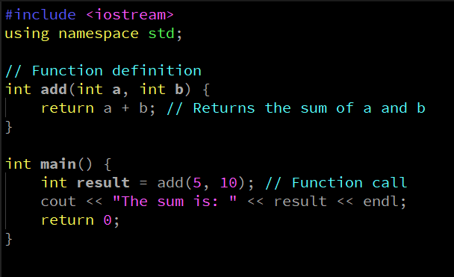
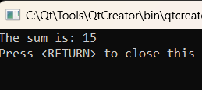
3. Functions & Modular Programming
Functions are fundamental building blocks that allow you to encapsulate code for specific tasks, making it reusable and organized.
Definition
A function is a self-contained block of code that performs a specific task. It can take inputs, called parameters, and can return an output.
Syntax
The basic syntax of a function
Example
Output

Slide 17
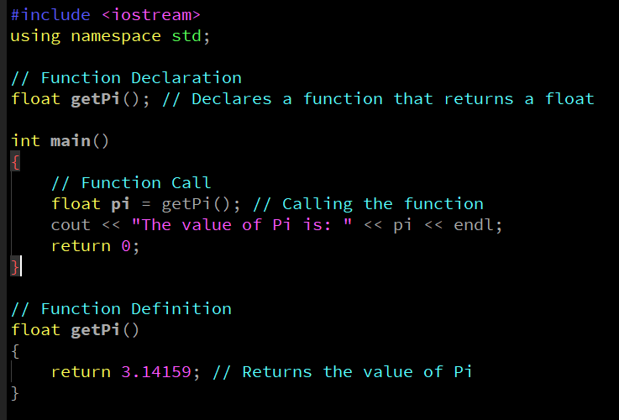
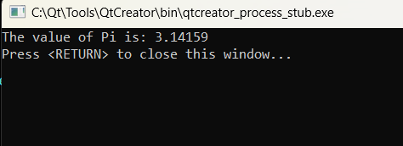
3.Functions & Modular Programming
The concept of functions:-
Example
Output

Slide 18
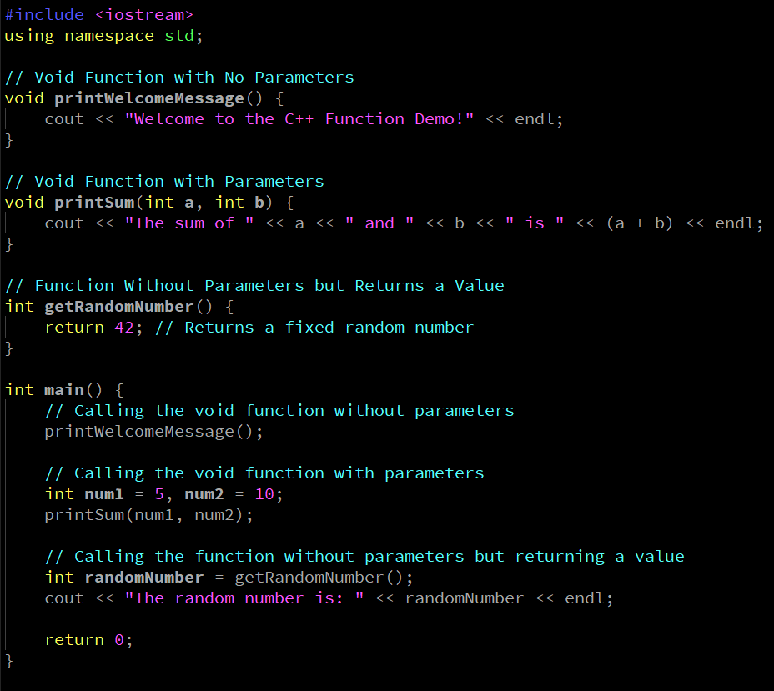
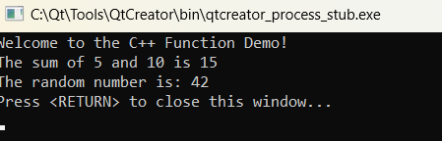
4. Functions & Modular Programming
Void Functions: Functions that do not return a value. They use the void keyword as the return type.
Functions without Parameters: These functions do not accept any parameters.
Functions with Parameters: These functions accept one or more parameters.
Example
Output

Slide 19
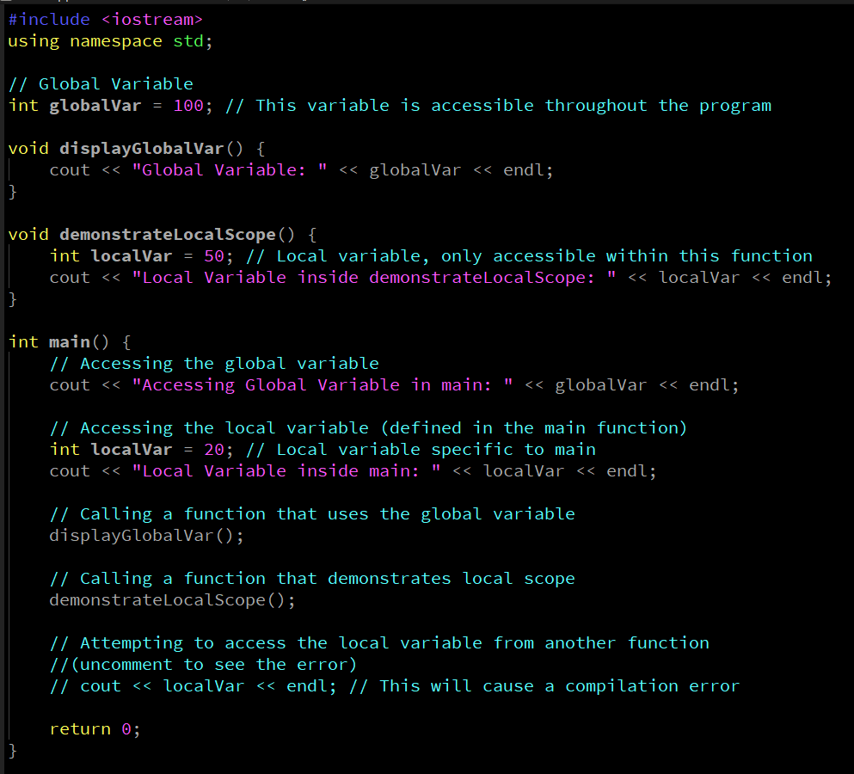
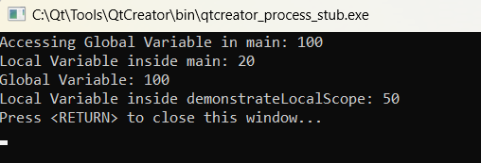
4. Functions & Modular Programming
In general, the scope is defined as the extent up to which something can be worked with. In programming also the scope of a variable is defined as the extent of the program code within which the variable can be accessed or declared or worked with.
There are mainly two types of variable scopes: 1.Local Variables 2.Global Variables
Example
Output

Slide 20
5. Arrays and Strings
An array is a data structure that is used to store multiple values of similar data types in a contiguous memory location. Properties of Arrays
An Array is a collection of data of the same data type, stored at a contiguous memory location.
Indexing of an array starts from 0. It means the first element is stored at the 0th index, the second at 1st, and so on.
Elements of an array can be accessed using their indices.
Once an array is declared its size remains constant throughout the program.
An array can have multiple dimensions.
The size of the array in bytes can be determined by the size of operator using which we can also find the number of elements in the array.
We can find the size of the type of elements stored in an array by subtracting adjacent addresses.

Slide 21
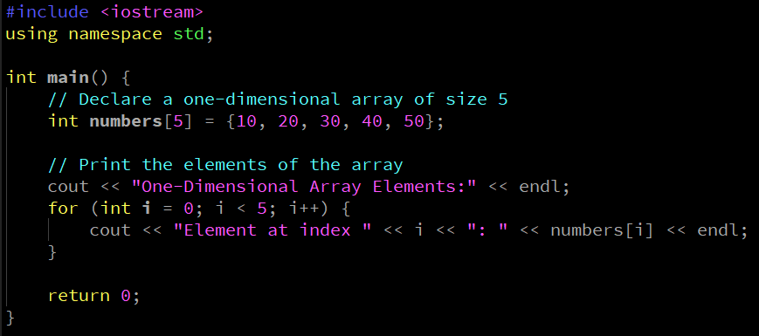
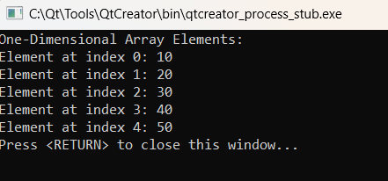
5. Arrays and Strings
One Dimensional Array:- std::array is an aggregate type, meaning it can be initialized with aggregate-initialization. It does not decay to a pointer automatically like a C-style array. For example, you can initialize an std::array as follows:
Example
Output

Slide 22
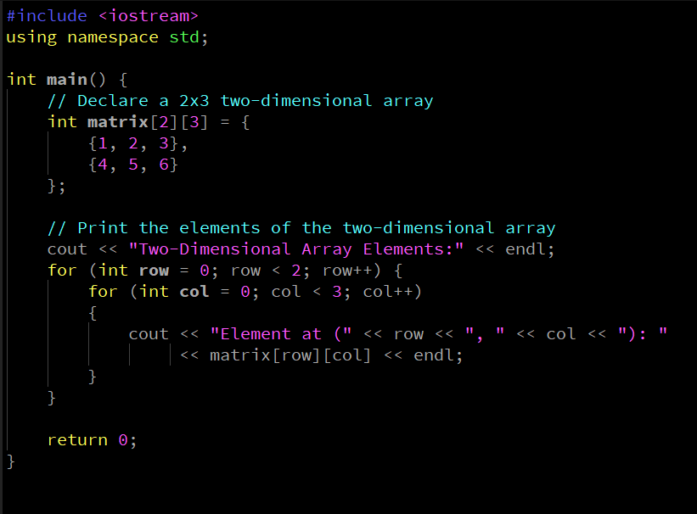
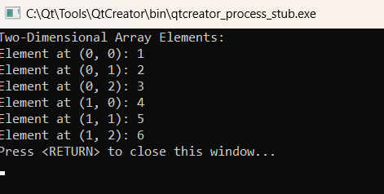
5. Arrays and Strings
Two-Dimensional Array:- The canonical way to create a two-dimensional array of std::array is to create a std::array where the template type argument is another std::array.
Example
Output

Slide 23
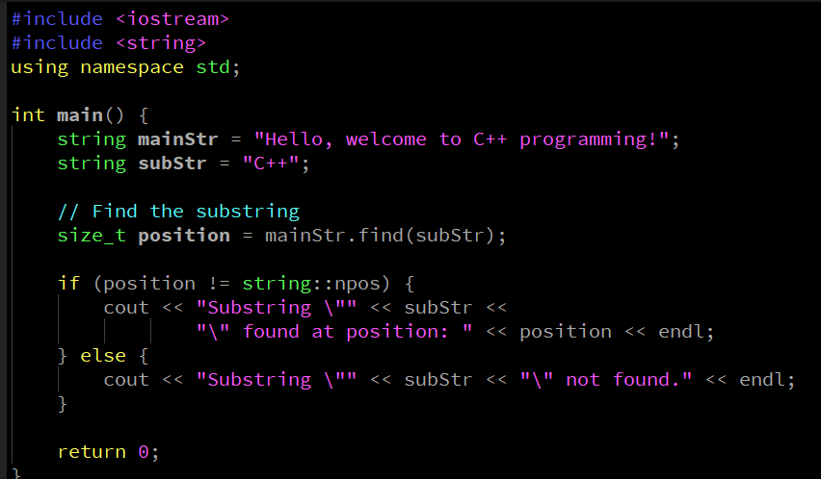
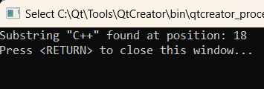
5. Arrays and Strings
Finding Substrings in a String
We can use the find() method of the std::string class to locate a substring within a string.
Explanation of find():
size_t find(const std::string& str, size_t pos = 0)
Searches for the first occurrence of str starting from position pos.
Returns the starting index of the substring if found.
Returns std::string::npos if not found.
Example
Output

Slide 24
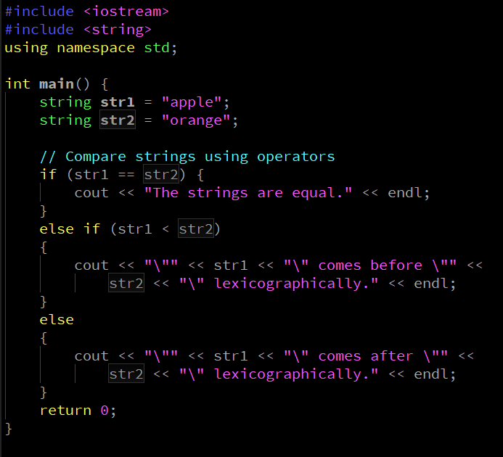
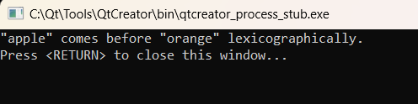
5. Arrays and Strings
Comparing Strings in C++
There are two main ways to compare strings in C++:
1.Using relational operators (==, !=, <, >, <=, >=).
2.Using the compare() method of std::string.
Example
Output

Slide 25
5. Arrays and Strings
Iterators
begin | Return iterator to beginning
end | Return iterator to end
rbegin | Return reverse iterator to reverse beginning
rend | Return reverse iterator to reverse end.
cbegin | Return const_iterator to beginning.
cend | Return const_iterator to end.​
crbegin | Return const_reverse_iterator to reverse beginning.
crend | Return const_reverse_iterator to reverse end.​
Modifiers
operator+= | Append to string (public member function)
Append | Append to string (public member function
push_back | Append character to string (public member function)
assign | Assign content to string (public member function)
insert | Insert into string (public member function)​
erase | Erase characters from string (public member function)​
Replace | Replace portion of string (public member function)
swap | Swap string values (public member function)
pop_back | Delete last character (public member function)​
Element access
Operator | Get character of string (public member function)​
at | Get character in string (public member function)​
back | Access last character (public member function)​
front | Access first character (public member function)​

Slide 26
5. Arrays and Strings
String operations
c_str | Get C string equivalent (public member function)
data | Get string data (public member function)
get_allocator | Get allocator (public member function)
copy | Copy sequence of characters from string (public member function)
find | Find content in string (public member function)
rfind | Find last occurrence of content in string (public member function)
find_first_of | Find character in string (public member function)
find_last_of | Find character in string from the end (public member function)
find_first_not_of | Find absence of character in string (public member function)
find_last_not_of | Find non-matching character in string from the end (public member function)
substr | Generate substring (public member function)
compare | Compare strings (public member function)

Slide 27


Thank You

